Slide 1

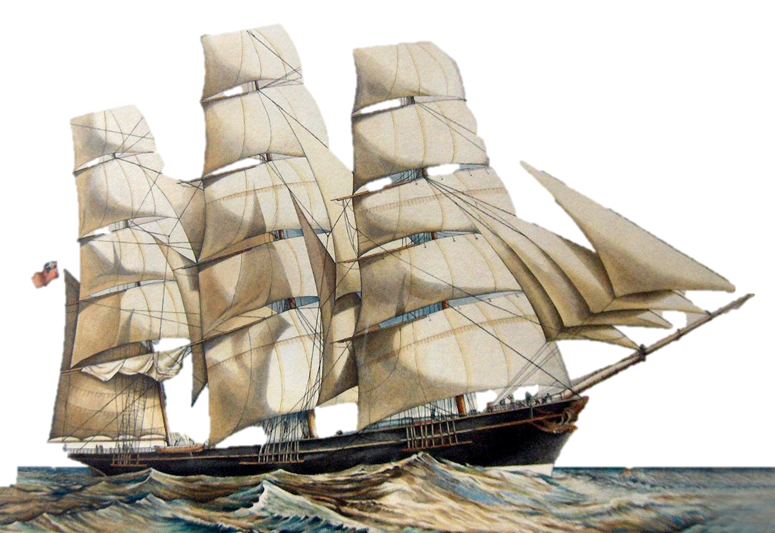
A Low-Latency Online Prediction Serving System
Clipper
Daniel Crankshaw
Stanford NetSeminar
February 1, 2018

Slide 2
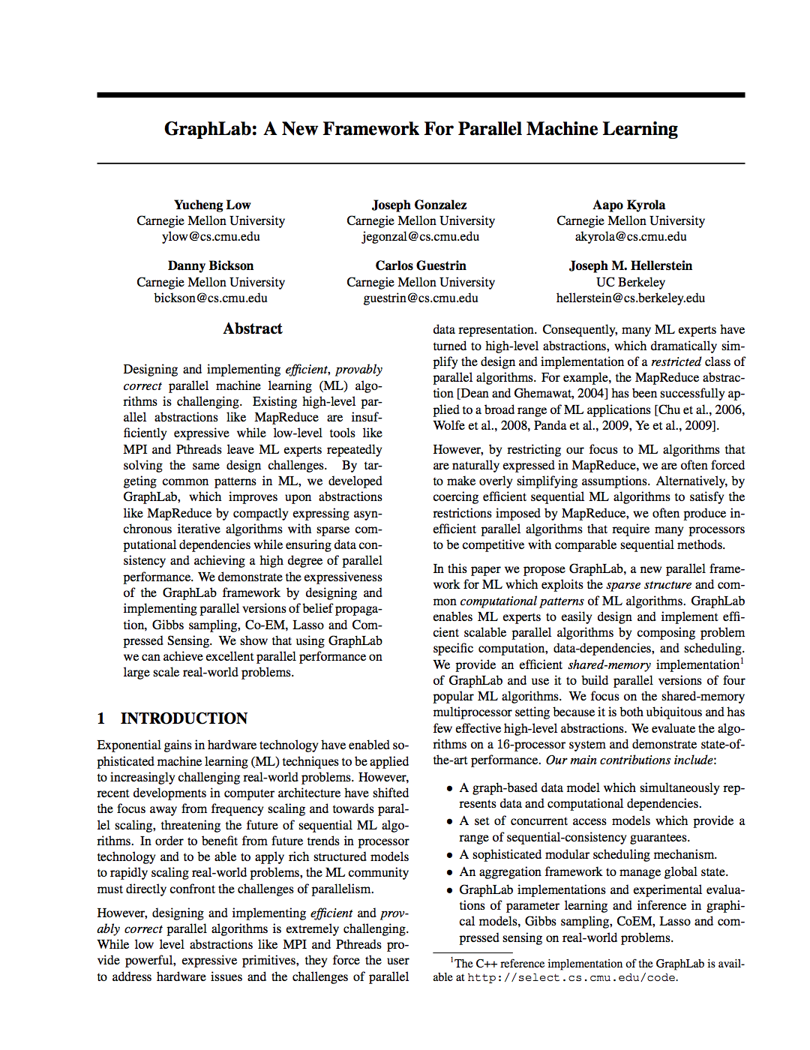
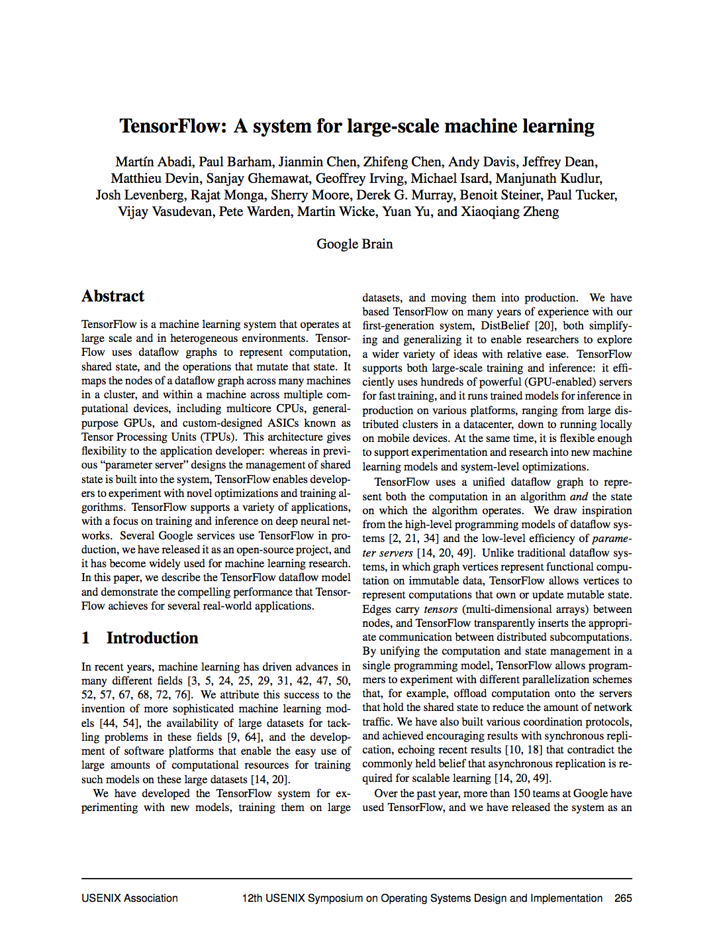
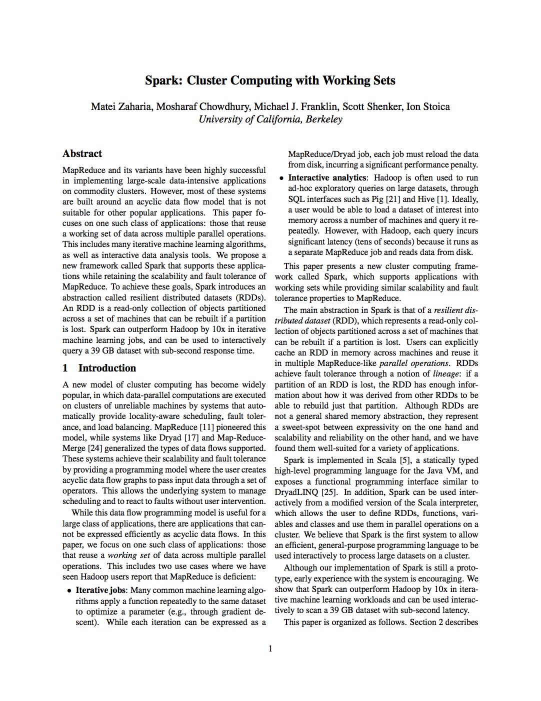
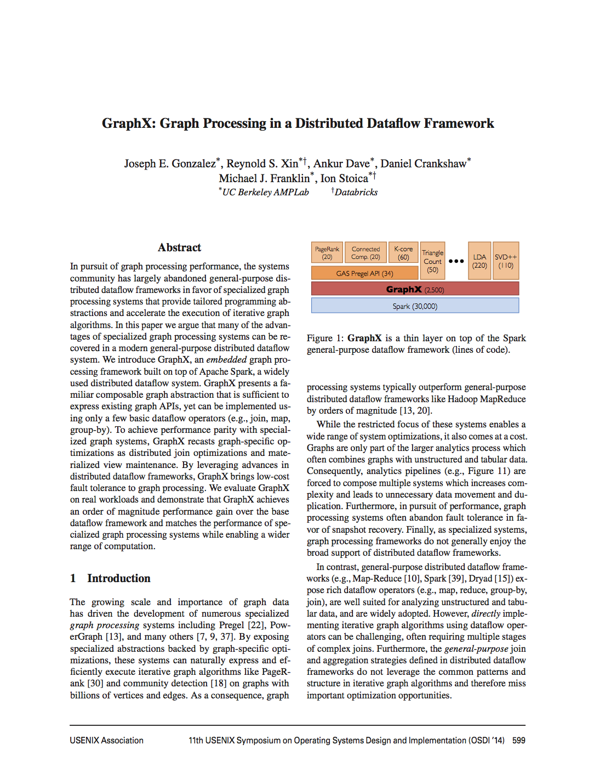
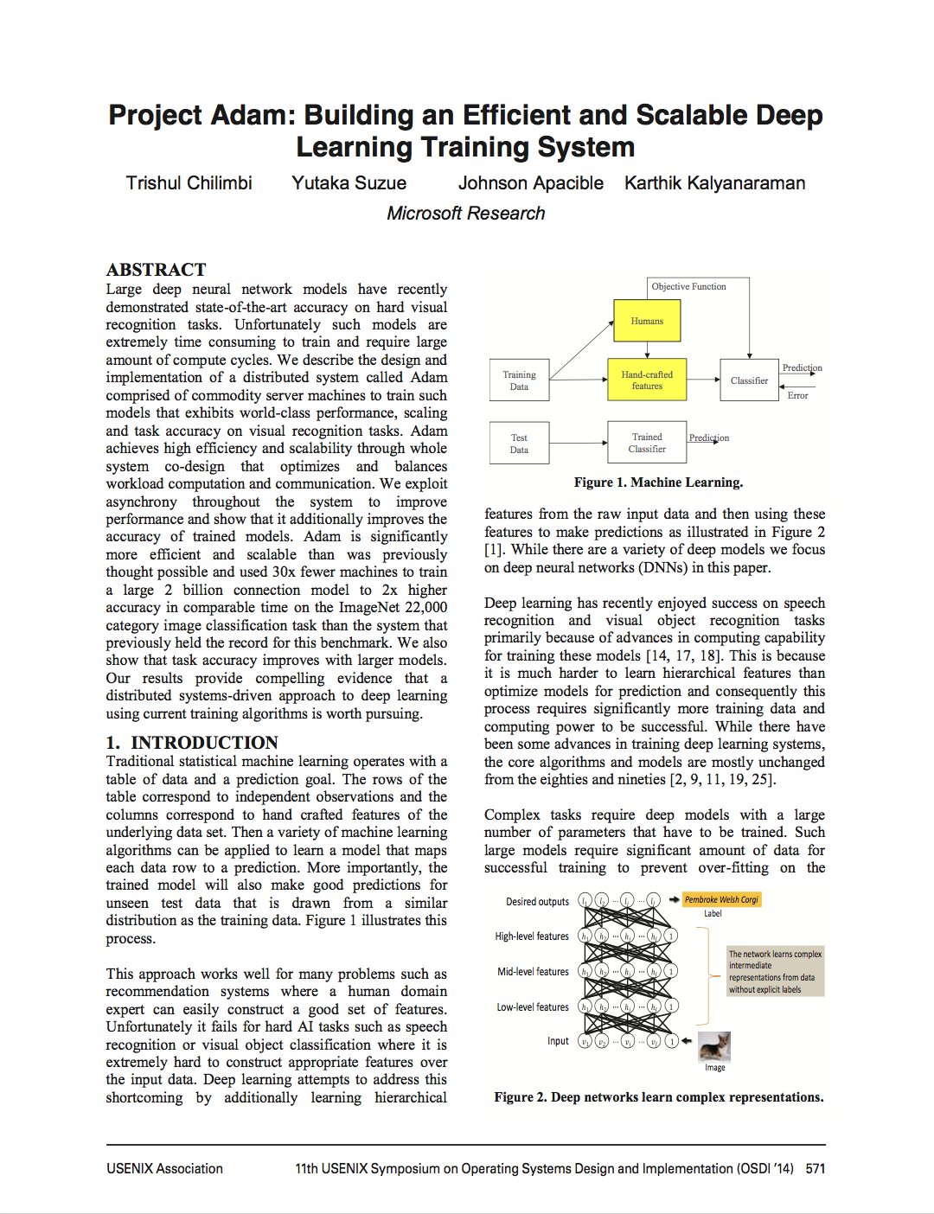
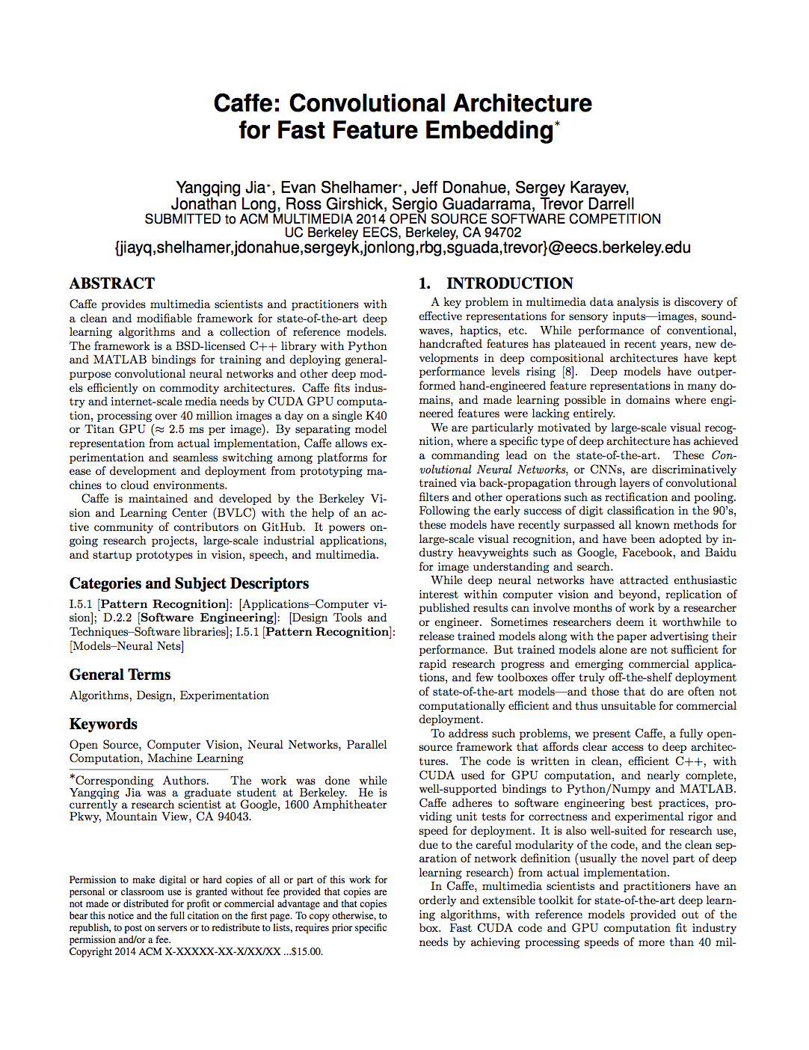
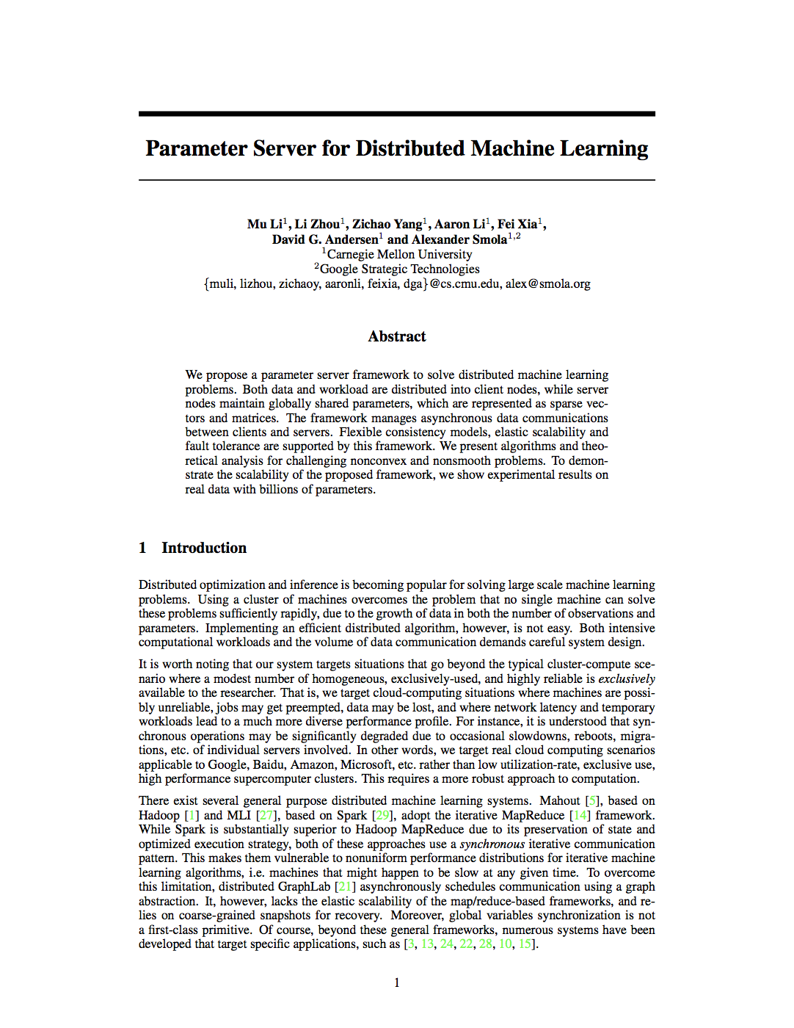
Learning
Big
Data
Training
Complex Model
Notes:
focus of systems for AI/ML has been training
cite paper logos instead of text

Slide 3
Learning
Big
Data
Training
Complex Model

Slide 4
Learning Produces a Trained Model
Query
Decision
“CAT”
Model

Slide 5
Learning
Serving
Query
Big
Data
?
Training
Decision
Model
Application

Slide 6
Serving
Learning
Query
Big
Data
Training
Decision
Model
Application
Prediction-Serving for interactive applications
Timescale: ~10s of milliseconds

Slide 7
Prediction-Serving Raises New Challenges

Slide 8








Prediction-Serving Challenges
???
Create
VW
Caffe
8
Large and growing ecosystem of ML models and frameworks
Support low-latency, high-throughput serving workloads

Slide 9
Support low-latency, high-throughput serving workloads
Models getting more complex
10s of GFLOPs [1]
Deployed on critical path
Maintain SLOs under heavy load
Using specialized hardware for predictions
[1] Deep Residual Learning for Image Recognition. He et al. CVPR 2015.
Notes:
FLOPs, numbers for models,

Slide 10
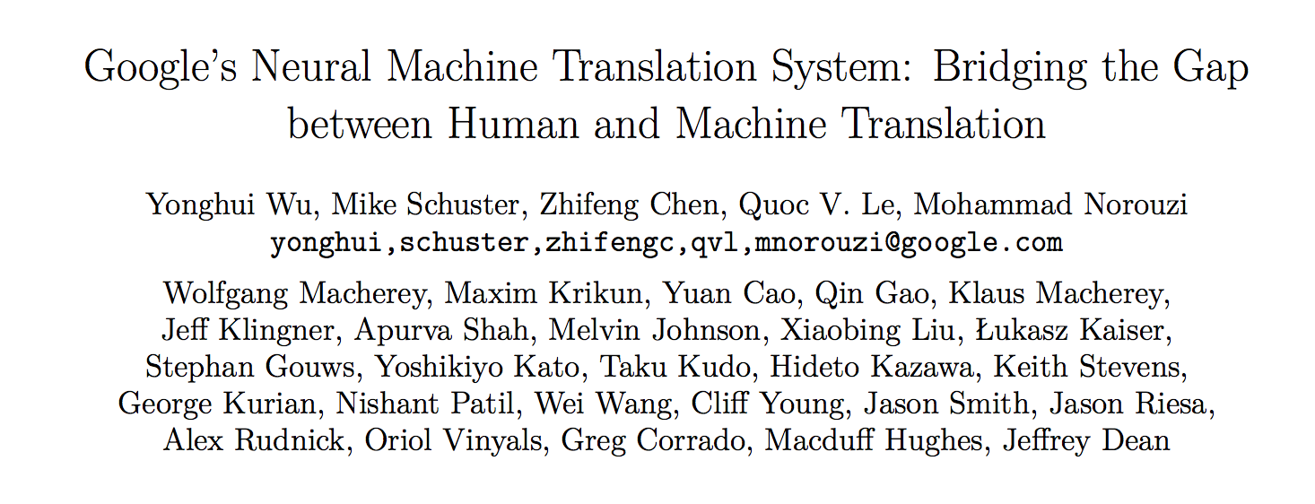
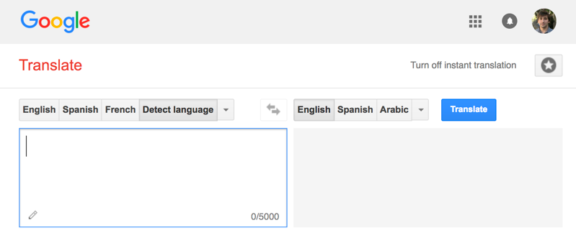
Google Translate
Serving
Invented New Hardware!
Tensor Processing Unit (TPU)
140 billion words a day¹
82,000 GPUs running 24/7
[1] https://www.nytimes.com/2016/12/14/magazine/the-great-ai-awakening.html

Slide 11

Big Companies Build One-Off Systems
Problems:
Expensive to build and maintain
Highly specialized and require ML and systems expertise
Tightly-coupled model and application
Difficult to change or update model
Only supports single ML framework

Slide 12
Prediction-Serving Challenges
???
Create
VW
Caffe
12
Large and growing ecosystem of ML models and frameworks
Support low-latency, high-throughput serving workloads

Slide 13
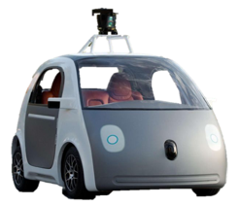






Large and growing ecosystem of ML models and frameworks
Fraud Detection
Content
Rec.
Personal
Asst.
Robotic
Control
Machine
Translation
???
VW
Create
Caffe
13
Notes:
Different models, different frameworks have different strengths
Give example of why all are needed
Multiple applications with different needs within an org
Even a single application may need to support multiple frameworks

Slide 14
Large and growing ecosystem of ML models and frameworks
Fraud Detection
Content
Rec.
Personal
Asst.
Robotic
Control
Machine
Translation
Difficult to deploy and brittle to manage
???
Varying physical resource requirements
VW
Create
Caffe

Slide 15
But most companies can’t build new serving systems…

Slide 16
Use existing systems: Offline Scoring
Big
Data
Training
Model
Batch Analytics

Slide 17
Use existing systems: Offline Scoring
Datastore
Big
Data
X | Y
Training
Scoring
Model
Batch Analytics

Slide 18
Use existing systems: Offline Scoring
Look up decision in datastore
Query
X | Y
Decision
Application
Low-Latency Serving

Slide 19
Use existing systems: Offline Scoring
Look up decision in datastore
Problems:
Requires full set of queries ahead of time
Small and bounded input domain
Wasted computation and space
Can render and store unneeded predictions
Costly to update
Re-run batch job
Query
X | Y
Decision
Application
Low-Latency Serving

Slide 20
Prediction-Serving Challenges
???
Create
VW
Caffe
20
Large and growing ecosystem of ML models and frameworks
Support low-latency, high-throughput serving workloads

Slide 21
How does Clipper address these challenges?
Notes:
Why a system? Because system challenges not AI challenges

Slide 22
Clipper Solutions
Simplifies deployment through layered architecture
Serves many models across ML frameworks concurrently
Employs caching, batching, scale-out for high-performance serving
Notes:
”Abstract away the model behind a uniform API”

Slide 23



Clipper Decouples Applications and Models
Applications
Predict
RPC/REST Interface
Feedback
Clipper
RPC
RPC
RPC
RPC
Model Container (MC)
MC
MC
MC
Caffe
VW
Create

Slide 24




Clipper Architecture
Applications
Predict
RPC/REST Interface
Observe
Clipper
Improve accuracy through bandit methods and ensembles, online learning, and personalization
Model Selection Layer
Model Abstraction Layer
Provide a common interface to models
while bounding latency and maximizing throughput.
RPC
RPC
RPC
RPC
Model Container (MC)
MC
MC
MC
Caffe
Notes:
because model-abstraction layer lets you plug in many models, model selection layer chooses between them
introduce learning in selection layer later

Slide 25
Clipper Architecture
Applications
Predict
RPC/REST Interface
Observe
Clipper
Model Selection Layer
Selection Policy
Model Abstraction Layer
Caching
Adaptive Batching
RPC
RPC
RPC
RPC
Model Container (MC)
MC
MC
MC
Caffe

Slide 26
Clipper Implementation
Applications
Predict
RPC/REST Interface
Observe
Clipper
ust
Core system: 5000 lines of Rust
RPC:
100 lines of Python
250 lines of Rust
200 lines of C++
Model Abstraction Layer
Caching
Adaptive Batching
RPC
RPC
RPC
RPC
Model Container (MC)
MC
MC
MC
Caffe

Slide 27
Applications
Predict
RPC/REST Interface
Observe
Clipper
Correction Layer
Correction Policy
Model Abstraction Layer
Caching
Adaptive Batching
RPC
RPC
RPC
RPC
Model Container (MC)
MC
MC
MC
Caffe
Provide a common interface to models while bounding latency and maximizing throughput.

Slide 28
Clipper
Correction Layer
Correction Policy
Model Abstraction Layer
Caching
Adaptive Batching
RPC
RPC
RPC
RPC
Model Container (MC)
MC
MC
MC
Caffe
Common Interface → Simplifies Deployment:
Evaluate models using original code & systems
Notes:
make containers green

Slide 29
Container-based Model Deployment
Implement Model API:
class ModelContainer:
def __init__(model_data)
def predict_batch(inputs)
Notes:
Black-box abstraction

Slide 30
Container-based Model Deployment
Implement Model API:
class ModelContainer:
def __init__(model_data)
def predict_batch(inputs)
Implemented in many languages
Python
Java
C/C++
Notes:
Data scientist doesn’t have to learn any new skills

Slide 31
Container-based Model Deployment
Model implementation packaged in container
Model Container (MC)
class ModelContainer:
def __init__(model_data)
def predict_batch(inputs)
VW
Create

Slide 32
Container-based Model Deployment
Clipper
RPC
RPC
RPC
RPC
Model Container (MC)
MC
MC
MC
Caffe
VW
Create
Notes:
From the frontend dev perspective Clipper

Slide 33
Clipper
Correction Layer
Correction Policy
Model Abstraction Layer
Caching
Adaptive Batching
RPC
RPC
RPC
RPC
Model Container (MC)
MC
MC
MC
Caffe
Common Interface → Simplifies Deployment:
Evaluate models using original code & systems
Models run in separate processes as Docker containers
Resource isolation

Slide 34
Clipper
Correction Layer
Correction Policy
Model Abstraction Layer
Caching
Adaptive Batching
RPC
RPC
RPC
RPC
RPC
RPC
Model Container (MC)
MC
MC
MC
MC
MC
Caffe
Common Interface → Simplifies Deployment:
Evaluate models using original code & systems
Models run in separate processes as Docker containers
Resource isolation
Scale-out
Problem: frameworks optimized for batch processing not latency

Slide 35
Batching to Improve Throughput
Why batching helps:
Optimal batch depends on:
hardware configuration
model and framework
system load
A single
page load may generate
many queries
Hardware
Acceleration
Helps amortize
system overhead
Notes:
Make clearer that batching navigates tradeoff between throughput and latency

Slide 36
Batching to Improve Throughput
Adaptive
Why batching helps:
Optimal batch depends on:
hardware configuration
model and framework
system load
A single
page load may generate
many queries
Clipper Solution:
Adaptively tradeoff latency and throughput…
Inc. batch size until the latency objective is exceeded (Additive Increase)
If latency exceeds SLO cut batch size by a fraction (Multiplicative Decrease)
Hardware
Acceleration
Helps amortize
system overhead

Slide 37
Tensor Flow Conv. Net (GPU)
Better
Throughput (Queries Per Second)
Batch Size
Notes:
Two plots, thorughput on top, latency on bottom

Slide 38
Tensor Flow Conv. Net (GPU)
Better
Throughput (Queries Per Second)
Latency (ms)
Better
Batch Size
Notes:
Two plots, thorughput on top, latency on bottom

Slide 39
Tensor Flow Conv. Net (GPU)
Better
Throughput (Queries Per Second)
Optimal Batch Size
Latency (ms)
Better
Batch Size
Notes:
Two plots, thorughput on top, latency on bottom

Slide 40
Better
Throughput
(QPS)

Slide 41
Better
Throughput
(QPS)

Slide 42
Better
Throughput
(QPS)
P99 Latency
(ms)
20 ms is
Fast Enough
Better

Slide 43
Throughput
(QPS)
P99 Latency
(ms)
Batch Size
Notes:
put batching on bottom

Slide 44
Overhead of decoupled architecture
Applications
Predict
RPC/REST Interface
Feedback
Clipper
RPC
RPC
RPC
RPC
MC
MC
MC
MC
Caffe

Slide 45
Overhead of decoupled architecture
Applications
Applications
Predict
RPC Interface
Predict
RPC/REST Interface
Feedback
TensorFlow-Serving
Clipper
RPC
RPC
RPC
RPC
MC
MC
MC
MC
Caffe
Notes:
adopts a more monolithic architecture with both the serving and model-evaluation code in a single process

Slide 46
Overhead of decoupled architecture
Applications
Applications
Predict
RPC/REST Interface
Feedback
Predict
RPC Interface
Clipper
TensorFlow-Serving
RPC
RPC
RPC
RPC
Model Container
MC
MC
MC
Caffe
Notes:
adopts a more monolithic architecture with both the serving and model-evaluation code in a single process

Slide 47
Overhead of decoupled architecture
Model: AlexNet trained on CIFAR-10
Better
P99 Latency
(ms)
Throughput
(QPS)
Better
TensorFlow Serving
Clipper
TensorFlow Serving
Clipper
Notes:
just cifar, cut python

Slide 48
Clipper Architecture
Applications
Predict
RPC/REST Interface
Observe
Clipper
Improve accuracy through bandit methods and ensembles, online learning, and personalization
Model Selection Layer
Model Abstraction Layer
Provide a common interface to models
while bounding latency and maximizing throughput.
RPC
RPC
RPC
RPC
Model Container (MC)
MC
MC
MC
Caffe
Notes:
because model-abstraction layer lets you plug in many models, model selection layer chooses between them
introduce learning in selection layer later

Slide 49

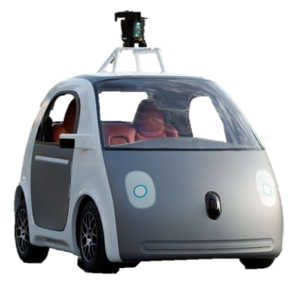
Applications
Predict
RPC/REST Interface
Observe
Clipper
Improve accuracy through bandit methods and ensembles, online learning, and personalization
Model Selection Layer
Version 1
Periodic retraining
Version 2
Version 3
Experiment with new models and frameworks
Caffe
Notes:
By combining predictions from multiple models we can improve application accuracy and quantify confidence in predictions

Slide 50
Selection Policy: Estimate confidence
Version 2
Version 3
“CAT”
“CAT”
CONFIDENT
“CAT”
Policy
“CAT”
“CAT”
Caffe

Slide 51
Selection Policy: Estimate confidence
“CAT”
“CAT”
UNSURE
“MAN”
Policy
“CAT”
Caffe
“SPACE”
Notes:
“Not a cat picture”

Slide 52
Selection Policy: Estimate confidence
Better
Notes:
put best model accuracy back in

Slide 53
Selection Policy: Estimate confidence
Better
width is percentage of query workloads

Slide 54
Selection policies supported by Clipper
Applications
Predict
RPC/REST Interface
Observe
Clipper
Model Selection Layer
Selection Policy
Exploit multiple models to estimate confidence
Use multi-armed bandit algorithms to learn optimal model-selection online
Online personalization across ML frameworks
*See paper for details

Slide 55
Research Prototype to Active Open-Source Project

Slide 56
RISE Stack (January 2018)
Mixed-autonomy
Traffic
Pylot
(self-driving platform)
Cloud robotics
Smart Buildings
Applications
Jarvis
Tegra
Opaque
Drizzle
Clipper
PyWren
Processing
RAY
TensorFlow, PyTorch, MXNet, Caffe2, …
Spark
RLlib
Ray Tune
Ground
(context metadata service)
WAVE
(decentralized authorization service)
Confluo
(formerly DiaLog)
HDFS, Kafka, Cassandra, DBMSes, …
Infrastructure
(cluster manager,
storage, authorization &
authentication,
metadata management, …)
FireSim
AWS, Azure, GCE, Kubernetes, Mesos, …

Slide 57
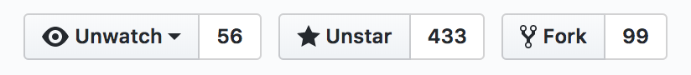
Status of the project
Threw away the research prototype and rewrote the system from scratch in C++
First released in May 2017 with a focus on usability
Development has focused on performance improvements, support for cloud deployments, and increased support for common machine learning frameworks
Supports native deployments on Kubernetes and a local Docker mode
First class support for several common machine learning frameworks: PyTorch, TensorFlow, Scikit-Learn, PySpark, R
18 contributors
Including 7 from outside Berkeley

Slide 58
Project Goals
Community-owned platform for model deployment and serving
Research platform for continued investigation into model serving and management in low-latency settings

Slide 59
Development Roadmap: Spring 2018
More explicit support for distributed cloud deployments
Support for running Clipper in replicated and partitioned modes for high-availability and scalability
Performance Optimizations
A recent research fork introduced several performance optimizations that are in the process of being ported back to the mainline code base
Metrics and Monitoring infrastructure using Prometheus
Comprehensive monitoring is critical for production infrastructure
Increased community outreach
We want community feedback on what is working, and what is not!

Slide 60
Research Roadmap
Support for increasingly complex machine-learning applications
InferLine: Serving multi-model pipelines on heterogeneous hardware
Serving RL policies and integration with Ray
Closing the loop between training and serving
Online model evaluation and monitoring to detect problems ASAP
Automatically decide when and how to retrain models
Integration of online learning and bandit algorithms with offline batch training

Slide 61
Serving Multi-Model Pipelines with InferLine (Work In Progress)

Slide 62
Trends in Applied Machine Learning
Else
Slow but accurate model
Task-specific model
If face detected
Face detector
If object detected
Fast model
If confident then return
Pre-trained DNN
Object detector
Ensembles can improve accuracy
Faster inference with prediction cascades
Faster development through model-reuse
Model specialization
How to efficiently support serving arbitrary model pipelines?

Slide 63
Trends in Applied Machine Learning
Specialized model → composing multiple models to render a single decision
More complex applications being made
GPU-capable
GPU-capable
ResNet
Inception
Ensemble of
Neural Features
Kernel
SVM
Logistic Regression
Notes:
We make an observation that there’s a marked trend in applied machine learning where application complexity requires shifting from just using a single specialized model to composing a number of models for the purpose of rendering a single decision. In this talk, we’re going to talk about how to compose multiple models for inference. One example of that is an ensemble of neural features, which uses two computer vision models, Resnet and Inception in parallel. The output of each then serves as input to two lighterweight CPU models, and then we combine their results into a single prediciton.
Let’s first set up the context for this talk. Machine Learning applications are no longer operating with a single model. They are increasingly complex, the trend is for applications to consume the results of more than one machine learning model for any given query. There’s a trend towards combining several models to
serve a facebook feed ,
or to make a decision to steer an autonomous vehicle,
or to serve interactive, multi-modal content to the end user.

Slide 64
Model Composition Patterns
Ensembles
AND
Model 1
Model 2
…
Model m
Notes:
In fact, we’ve identified a number of practically motivated model composition patterns:
Ensembles : querying multiple models to render more accurate predictions

Slide 65
Model Composition Patterns
Multi-armed bandits
OR
p1
p2
pi
pm
Bandit 1
Bandit 2
…
Bandit m
Notes:
Bandit-stile algorithms

Slide 66
Model Composition Patterns
Neural Features/Models as transformers
Model 1
…
Model m
Notes:
Conditional execution models where models are exucuted conditionally , for various reasons,
For example

Slide 67
Model Composition Patterns
Cascades
p1
Model 1
p2
Model 2
pi
…
pm
Model m
Ref: Xin Wang et al, IDK Cascades: Fast Deep Learning by Learning not to Overthink
Notes:
Conditional execution models where models are exucuted conditionally , for various reasons,
For example

Slide 68
Model Composition Patterns
E.g. ensemble of Cascades
p11
p21
Model11
Model21
p12
p22
Model12
Model22

Slide 69
Model Serving Considerations
throughput
Latency (ms)
Latency SLO
Batch size
Notes:
For all of these models, deploying even a single model requires us to think about the effect of controlling various model parameters for optimal performance.
For example, picking a batch size has a profound and varied effect on throughput as well as latency. Yet simply going with the maximum batch size may be undesirable if we’re dealing with latency SLOs.
Optimally configuring models even for a single model deployment proved in itself a challenge and warranted discussion in the preceding NSDI 2017 paper.

Slide 70
Global Reasoning: Motivating Example
Model 1
Model 2
Latency SLO = 300ms
Batch size | throughput | Latency(ms)
1 | 40 | 80
5 | 80 | 150
10 | 100 | 180
Batch size | throughput | Latency(ms)
1 | 10 | 100
5 | 20 | 150
10 | 30 | 200
Notes:
Now let us see what happens when you have multiple models in a pipeline.
Let’s say we have these two models, m1 and m2, with the output of m1 serving as input to m2.
And let’s say that the profiler told us that throughput and latency for model 1 depend on batch size in the following way.
So, you might be tempted to maximize throughput greedily by setting the batch size to its maximum setting. If you do that, however,
You will leave only 120ms of slack for model m2, which leaves you with but a single option for model 2 batch size.
And we end up in a suboptimal configuration setting. Turns on the second model is a bottleneck, so, with batch size of 1, it yields the throughput of 10qps, which becomes the throughput of the overall pipeline.
If we were to go with the smallest batch size for model 1 and the largest batch size for model 2, you have 3x improvement in overall pipeline throughput from 10 qps to 30 qps.
-----------------------
Let us look at an example of configuring a pipeline that consists of two models m1 and m2. Let’s say for m1 we have the following relationship between the batch size and the models throughput and latency.
…
And for m2 we have this relationship.
If you were to greedily maximize throughput for m1, you might choose batch size of 10,

Slide 71
Global Reasoning: Motivating Example
Model 1
Model 2
Latency SLO = 300ms
Batch size | throughput | Latency(ms)
1 | 40 | 80
5 | 80 | 150
10 | 100 | 180
Batch size | throughput | Latency(ms)
1 | 10 | 100
5 | 20 | 150
10 | 30 | 200
Notes:
Now let us see what happens when you have multiple models in a pipeline.
Let’s say we have these two models, m1 and m2, with the output of m1 serving as input to m2.
And let’s say that the profiler told us that throughput and latency for model 1 depend on batch size in the following way.
So, you might be tempted to maximize throughput greedily by setting the batch size to its maximum setting. If you do that, however,
You will leave only 120ms of slack for model m2, which leaves you with but a single option for model 2 batch size.
And we end up in a suboptimal configuration setting. Turns on the second model is a bottleneck, so, with batch size of 1, it yields the throughput of 10qps, which becomes the throughput of the overall pipeline.
If we were to go with the smallest batch size for model 1 and the largest batch size for model 2, you have 3x improvement in overall pipeline throughput from 10 qps to 30 qps.
-----------------------
Let us look at an example of configuring a pipeline that consists of two models m1 and m2. Let’s say for m1 we have the following relationship between the batch size and the models throughput and latency.
…
And for m2 we have this relationship.
If you were to greedily maximize throughput for m1, you might choose batch size of 10,

Slide 72
Global Reasoning: Motivating Example
Model 1
Model 2
Latency SLO = 300ms
Batch size | throughput | Latency(ms)
1 | 40 | 80
5 | 80 | 150
10 | 100 | 180
Batch size | throughput | Latency(ms)
1 | 10 | 100
5 | 20 | 150
10 | 30 | 200
bs1 = 10 → throughput1 = 100
Notes:
Now let us see what happens when you have multiple models in a pipeline.
Let’s say we have these two models, m1 and m2, with the output of m1 serving as input to m2.
And let’s say that the profiler told us that throughput and latency for model 1 depend on batch size in the following way.
So, you might be tempted to maximize throughput greedily by setting the batch size to its maximum setting. If you do that, however,
You will leave only 120ms of slack for model m2, which leaves you with but a single option for model 2 batch size.
And we end up in a suboptimal configuration setting. Turns on the second model is a bottleneck, so, with batch size of 1, it yields the throughput of 10qps, which becomes the throughput of the overall pipeline.
If we were to go with the smallest batch size for model 1 and the largest batch size for model 2, you have 3x improvement in overall pipeline throughput from 10 qps to 30 qps.
-----------------------
Let us look at an example of configuring a pipeline that consists of two models m1 and m2. Let’s say for m1 we have the following relationship between the batch size and the models throughput and latency.
…
And for m2 we have this relationship.
If you were to greedily maximize throughput for m1, you might choose batch size of 10,

Slide 73
Global Reasoning: Motivating Example
Model 1
Model 2
Latency SLO = 300ms
Batch size | throughput | Latency(ms)
1 | 40 | 80
5 | 80 | 150
10 | 100 | 180
Batch size | throughput | Latency(ms)
1 | 10 | 100
5 | 20 | 150
10 | 30 | 200
bs1 = 10 → throughput1 = 100
bs2 = 1 → throughput2 = 10
Pipeline throughput = 10
Notes:
Now let us see what happens when you have multiple models in a pipeline.
Let’s say we have these two models, m1 and m2, with the output of m1 serving as input to m2.
And let’s say that the profiler told us that throughput and latency for model 1 depend on batch size in the following way.
So, you might be tempted to maximize throughput greedily by setting the batch size to its maximum setting. If you do that, however,
You will leave only 120ms of slack for model m2, which leaves you with but a single option for model 2 batch size.
And we end up in a suboptimal configuration setting. Turns on the second model is a bottleneck, so, with batch size of 1, it yields the throughput of 10qps, which becomes the throughput of the overall pipeline.
If we were to go with the smallest batch size for model 1 and the largest batch size for model 2, you have 3x improvement in overall pipeline throughput from 10 qps to 30 qps.
-----------------------
Let us look at an example of configuring a pipeline that consists of two models m1 and m2. Let’s say for m1 we have the following relationship between the batch size and the models throughput and latency.
…
And for m2 we have this relationship.
If you were to greedily maximize throughput for m1, you might choose batch size of 10,

Slide 74
Global Reasoning: Motivating Example
Model 1
Model 2
Latency SLO = 300ms
Batch size | throughput | Latency(ms)
1 | 40 | 80
5 | 80 | 150
10 | 100 | 180
Batch size | throughput | Latency(ms)
1 | 10 | 100
5 | 20 | 150
10 | 30 | 200
bs1 = 10 → throughput1 = 100
bs2 = 10 → throughput2 = 30
bs1 = 1 → throughput1 = 40
Pipeline throughput = 30
bs2 = 1 → throughput2 = 10
Pipeline throughput = 10
Notes:
Now let us see what happens when you have multiple models in a pipeline.
Let’s say we have these two models, m1 and m2, with the output of m1 serving as input to m2.
And let’s say that the profiler told us that throughput and latency for model 1 depend on batch size in the following way.
So, you might be tempted to maximize throughput greedily by setting the batch size to its maximum setting. If you do that, however,
You will leave only 120ms of slack for model m2, which leaves you with but a single option for model 2 batch size.
And we end up in a suboptimal configuration setting. Turns on the second model is a bottleneck, so, with batch size of 1, it yields the throughput of 10qps, which becomes the throughput of the overall pipeline.
If we were to go with the smallest batch size for model 1 and the largest batch size for model 2, you have 3x improvement in overall pipeline throughput from 10 qps to 30 qps.
-----------------------
Let us look at an example of configuring a pipeline that consists of two models m1 and m2. Let’s say for m1 we have the following relationship between the batch size and the models throughput and latency.
…
And for m2 we have this relationship.
If you were to greedily maximize throughput for m1, you might choose batch size of 10,

Slide 75
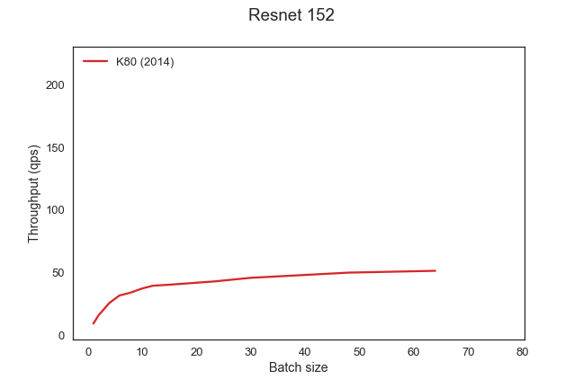
Model Performance/Cost
Latency Greedy
GPU | Cost ($/hr) | Cloud
K80 | 0.90 | AWS
P100 | 1.46 | GCP
V100 | 3.06 | AWS
Notes:
And batch size is just one of the parameters we have to consider. Resources allocated to models is another. Here we have three different types of GPUs ranging from 0.90 to over 3 dollars per hour. With the throughput difference of 4.3x between the cheapest and the most expensive GPU.
So, you might be tempted to maximize throughput for this model and go with the most expensive GPU. But what if this is not the bottleneck model? What if it’s model 1 from the previous slide? Then the extra cost is wasteful, because the pipeline is limited by the 30 qps throughput of the second model. So the right choice here is actually the cheapest GPU, as it minimizes cost without affecting throughput.
I can pick to run a model on a K80 GPU at 0.90 dollars per hour on on a V100 GPU at $3 per hour. The difference for that particular model would be 4.3x in throughput. Now what if it’s a decision I’m making for model 1 on the previous slide?

Slide 76
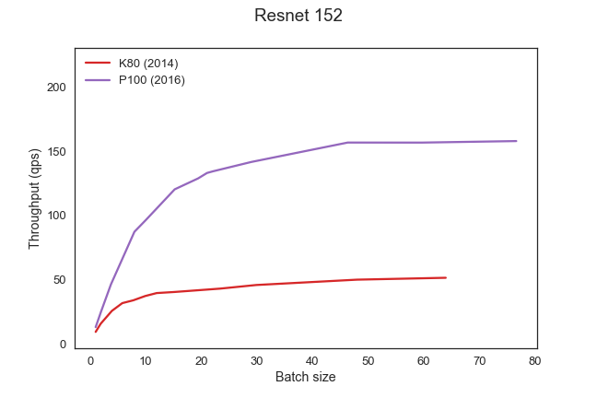
Model Performance/Cost
Latency Greedy
GPU | Cost ($/hr) | Cloud
K80 | 0.90 | AWS
P100 | 1.46 | GCP
V100 | 3.06 | AWS
Notes:
And batch size is just one of the parameters we have to consider. Resources allocated to models is another. Here we have three different types of GPUs ranging from 0.90 to over 3 dollars per hour. With the throughput difference of 4.3x between the cheapest and the most expensive GPU.
So, you might be tempted to maximize throughput for this model and go with the most expensive GPU. But what if this is not the bottleneck model? What if it’s model 1 from the previous slide? Then the extra cost is wasteful, because the pipeline is limited by the 30 qps throughput of the second model. So the right choice here is actually the cheapest GPU, as it minimizes cost without affecting throughput.
I can pick to run a model on a K80 GPU at 0.90 dollars per hour on on a V100 GPU at $3 per hour. The difference for that particular model would be 4.3x in throughput. Now what if it’s a decision I’m making for model 1 on the previous slide?

Slide 77
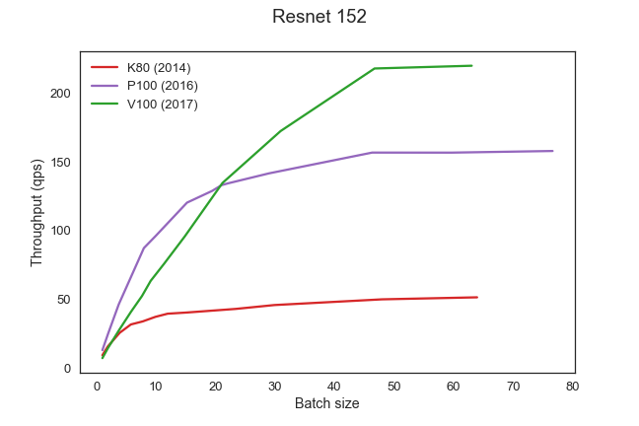
Model Performance/Cost
Model 1
Model 2
Latency Greedy
GPU | Cost ($/hr) | Cloud
K80 | 0.90 | AWS
P100 | 1.46 | GCP
V100 | 3.06 | AWS
Notes:
And batch size is just one of the parameters we have to consider. Resources allocated to models is another. Here we have three different types of GPUs ranging from 0.90 to over 3 dollars per hour. With the throughput difference of 4.3x between the cheapest and the most expensive GPU.
So, you might be tempted to maximize throughput for this model and go with the most expensive GPU. But what if this is not the bottleneck model? What if it’s model 1 from the previous slide? Then the extra cost is wasteful, because the pipeline is limited by the 30 qps throughput of the second model. So the right choice here is actually the cheapest GPU, as it minimizes cost without affecting throughput.
I can pick to run a model on a K80 GPU at 0.90 dollars per hour on on a V100 GPU at $3 per hour. The difference for that particular model would be 4.3x in throughput. Now what if it’s a decision I’m making for model 1 on the previous slide?

Slide 78
Model Configuration: Control Parameters
Batch size
Exploiting internal parallelism of the model
Physical resource allocation
GPU allocation (Usually decision is either 0 or 1)
CPU allocation
Replication factor
Exploiting external parallelism
Notes:
So we have a number of control parameters for each of the models to control: batch size, physical resource allocation, as well as the replication factor.
For each of these nodes in the DAGs you’ve just seen, there’s a number of configuration parameters that can be tuned:
What resources they run on,
What batch size the use internally
And how many replicas of each logical node in the DAG there are.

Slide 79
Problem Statement
Per-model configuration requires global reasoning
Each pipeline component contributes latency
Each model affects pipeline balance → pipeline throughput
Combinatorial number of pipeline configurations
per-model parameters: batch size, replication factor
In the number of model types
In the number of resource types
How do we capture and provision a well-balanced cost-efficient inference pipeline?
Notes:
This brings me to the problem statement of this work : in composed inference pipelines, per-mnodel configuration requires global reasoning.
This presents us with a combinatorial number of pipeline configurations to consider.
The question is how do we capture and provision a well balanced cost-efficient inference pipeline.
==============
Capture is to grab from profiler everything the optimizer needs
Optimizer produces how to provision
When pipelining models, per-model configuration cannot be localized
First, it is important to underscore that when models are pipelined, you cannot individually configure these models in a localized fashion. In other words, in order to configure
some model in a pipeline, it can only be done by considering the effect of that on the whole pipeline. The reason for this is that it contributes latency and may miss the end-to-end latency SLO.
This configuration may also shift the throughput bottleneck in the pipeline all of a sudden increasing the effective batch size downstream, which, in turn, may increase downstream latency, which in turn may miss latency SLOs.

Slide 80
System Goals
Well-balanced inference pipeline
For heterogeneous models
On heterogeneous hardware
Cost-efficient pipeline provisioning
Minimize cost to achieve desired latency and throughput SLO
Expressive/general for arbitrary pipelines & constraints:
Conditional/probabilistic, bandits, cascades
Application throughput targets, cost budget, latency SLO
Notes:
This brings us to the goals/contributions of the system.
The primary goal of InferLine is to provision well-balanced infererence pipelines. It must be done in a cost-efficient manner and with enough flexibility to optimize for relevant constraints, such as desired throughput, cost budget, if any, and the end-to-end latency service level objective.

Slide 81
InferLine Architecture
Driver.py
Sample queries
Constraints
SLO
Throughput
Cost
Profiler
Optimizer
Per model conf
Batch size
#replicas
Resource bundle
Notes:
To that end, we’ve designed Inferline – a framework for pipelined model inference composition.
Here’s a high level overview of some of its main components.

Slide 82
InferLine Architecture
Driver.py
Sample queries
Constraints
SLO
Throughput
Cost
Optimizer
Per model conf
Batch size
#replicas
Resource bundle
Notes:
Zooming in on the Profiler, it is responsible for two things:
First, empirically extracting the DAG structure of the pipeline, given the sample queries on input.
Second, profiling individual models to evaluate their throughput and latency performance over a small set of available resource bundles.
Combining the output of these two profiling steps, the Profiler then fuses the results into algebraic expressions that serve as the interface to the Optimizer.

Slide 83
InferLine Architecture
Driver.py
Sample queries
Constraints
SLO
Throughput
Cost
Profiler
Per model conf
Batch size
#replicas
Resource bundle
Notes:
The Optimizer takes these expressions on input and compiles them to quadratic programming problems, which it subsequently solves to produce per-model configurations.
Specifically, for each model the optimizer outputs : the batch size for that model, number of replicas, and the resource bundle to use.
Examples of resource bundles, include <1GPU, 1CPU> , <0 GPU, 1CPU> . It is essentially a vector of resources allocated to a given model in the pipeline.
In the rest of the talk we are going to focus on the Optimizer, the design of its interface, and its expressive power to encode relevant inference pipelines we see in practice.

Slide 84
Conclusion
Challenges of serving increasingly complex models trained in variety of frameworks while meeting strict performance demands
Clipper adopts a container-based architecture and employs prediction caching and latency-aware batching
Ongoing efforts on a workload-aware optimizer to optimize the deployment of complex, multi-model pipelines
crankshaw@berkeley.edu
http://clipper.ai
https://github.com/ucbrise/clipper

Slide 85
GPU Cluster Scaling

